Slide 1
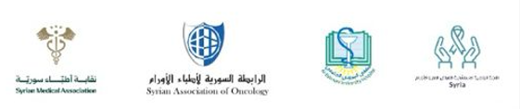
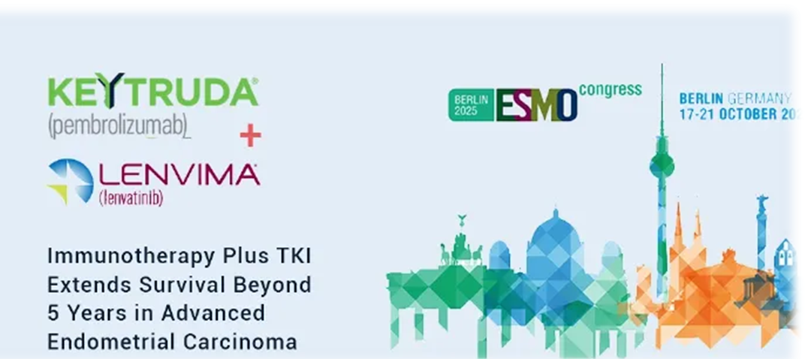
ESMO 2025 : Endometrial Cancer: A Five-year durability signal
Pembrolizumab + lenvatinib (KEYNOTE-775 / Study 309)
Maha Manachi , MD
AL- Bairouni University Hospital
Updates on Oncology Advances
SAO 2025

Slide 2
Concern
Increased withdrawal rate: The number of withdrawn oncology drug indications has increased in recent years. For example, a recent study found that between 1992 and August 2024, 34 of 226 (up to 22%) oncology accelerated approvals were withdrawn.
Concentrated recent withdrawals: The majority of the withdrawals have occurred in the last five years. For instance, as of April 2023, 17 of 23 withdrawn accelerated approvals had occurred in the previous three years.
Reasons for withdrawal: Withdrawals are typically due to failed confirmatory trials that do not meet the protocol-specified primary endpoint or fail to demonstrate clinical benefit.
Timeframe for withdrawal: The time from accelerated approval to withdrawal can vary significantly. The median time from approval to withdrawal was 4.1 years as of July 2023, with 53.8% of withdrawals occurring within two years prior to that study's end date.
Other outcomes: While some oncology drugs are withdrawn, many accelerated approvals are converted to full approval (62.5% of accelerated approvals between 1992 and 2024).
eClinicalMedicine. 2025 May 31;84:103088. doi: 10.1016/j.eclinm.2025.103088
Notes:
eClinicalMedicine. 2025 May 31;84:103088. doi: 10.1016/j.eclinm.2025.103088

Slide 3
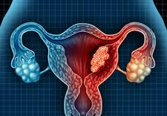

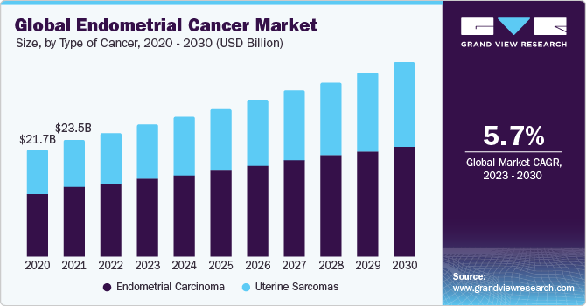
Endometrial cancer : Global Incidence& Statistics
(WHO) : is the sixth most common cancer in women globally, 2.2% of all new cancer cases. Higher in developed countries.
Worldwide incidence has increased significantly . About 70% diagnosed when the cancer is in an early stage.
Approximately 10 to 15% of patients present with advanced-stage disease,5 and 5-year survival among patients with distant metastases has been reported to be 17%.
Risk factors: prolonged exposure to Estrogen is a primary risk factor. Women with early menarche, late menopause, or who have never been pregnant .
Future projections: it is projected that the incidence of endometrial cancer in postmenopausal women aged 55 and above will increase by 6.5% by 2036.
Age-specific incidence of uterine cancer was highest for women aged 60–64 years.
This is attributed to the rising incidence of endometrial cancer, growing advancements in early detection & diagnosis,
increasing number of research & development in the oncology fields.
increasing adoption of personalized medicines & targeted therapies is anticipated to further fuel the growth of the market from 2023 to 2030.
Notes:
About 69% of uterine cancers are diagnosed when the cancer is in an early stage. This is largely because abnormal vaginal bleeding is an early symptom
The World Health Organization (WHO) has reported that endometrial (uterine) cancer is the sixth most common cancer in women globally. In 2022, there were 420,368 new cases worldwide, with the highest numbers in China, the US, and Russia. The incidence is higher in developed countries but is projected to increase significantly worldwide by 2040

Slide 4
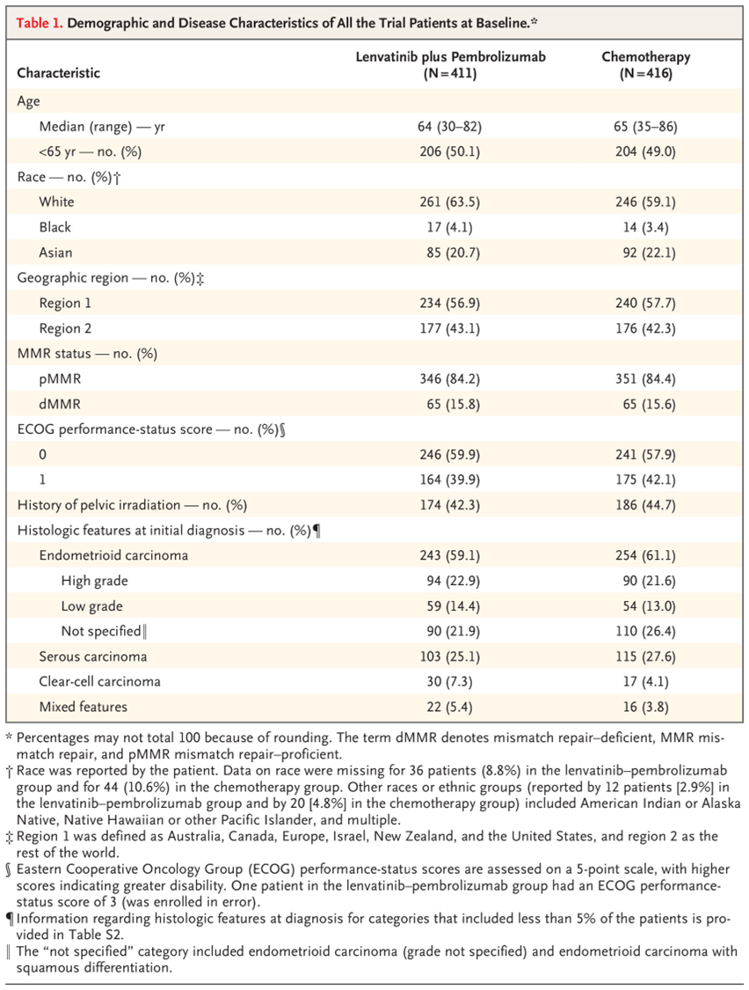
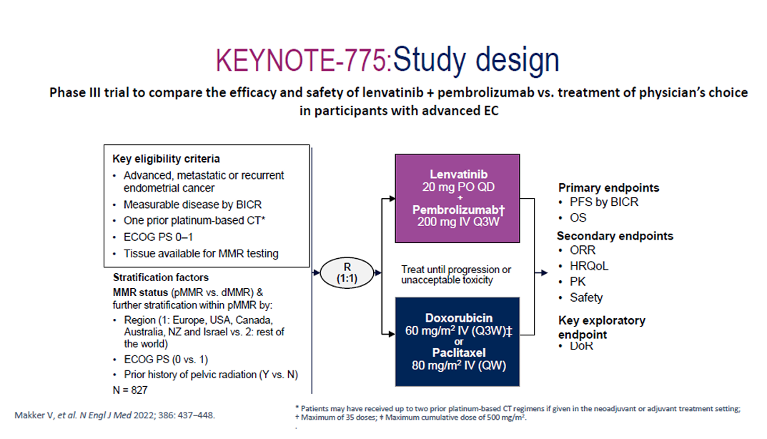
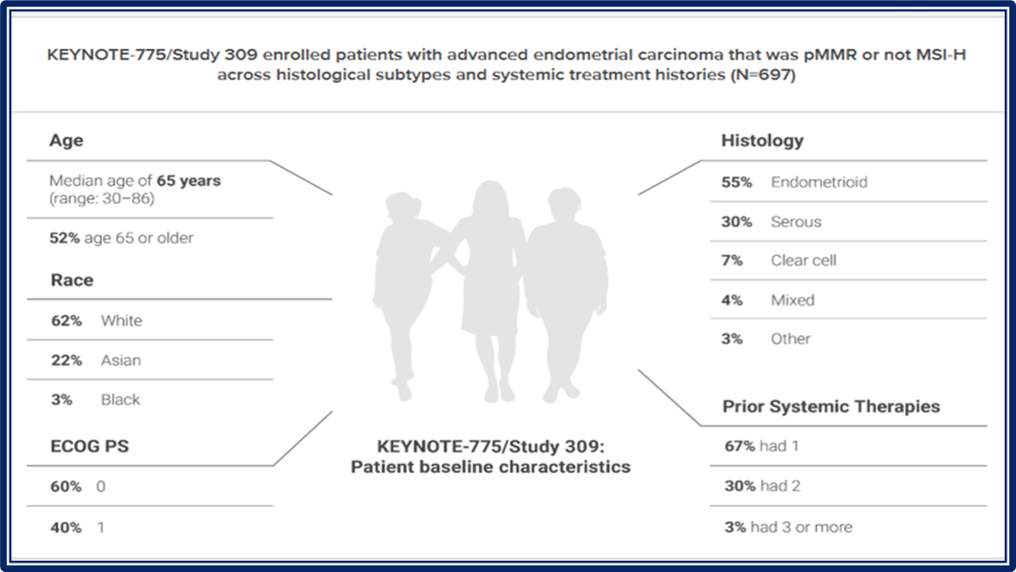
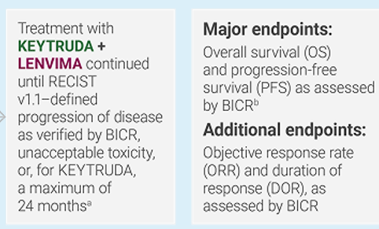
ESMO 2025 : Endometrial Cancer: A Five-Year Durability Signal
Pembrolizumab + lenvatinib (KEYNOTE-775 / Study 309)
The FIRST AND ONLY anti–PD-1 + TKI combination approved for adult patients with certain types of advanced endometrial carcinoma.
Pembrolizumab: checkpoint inhibitor that targets PD-1 (programmed death-1) receptor,
Lenvatinib is a multi-kinase inhibitor that targets VEGFR, FGFR, PDGFRα, RET, and KIT, and works by inhibiting angiogenesis and tumor proliferation.
The combination aims to synergize immune activation with anti-angiogenic effects,
Study 309/KEYNOTE-775 (ClinicalTrials.gov, NCT03517449

Slide 5
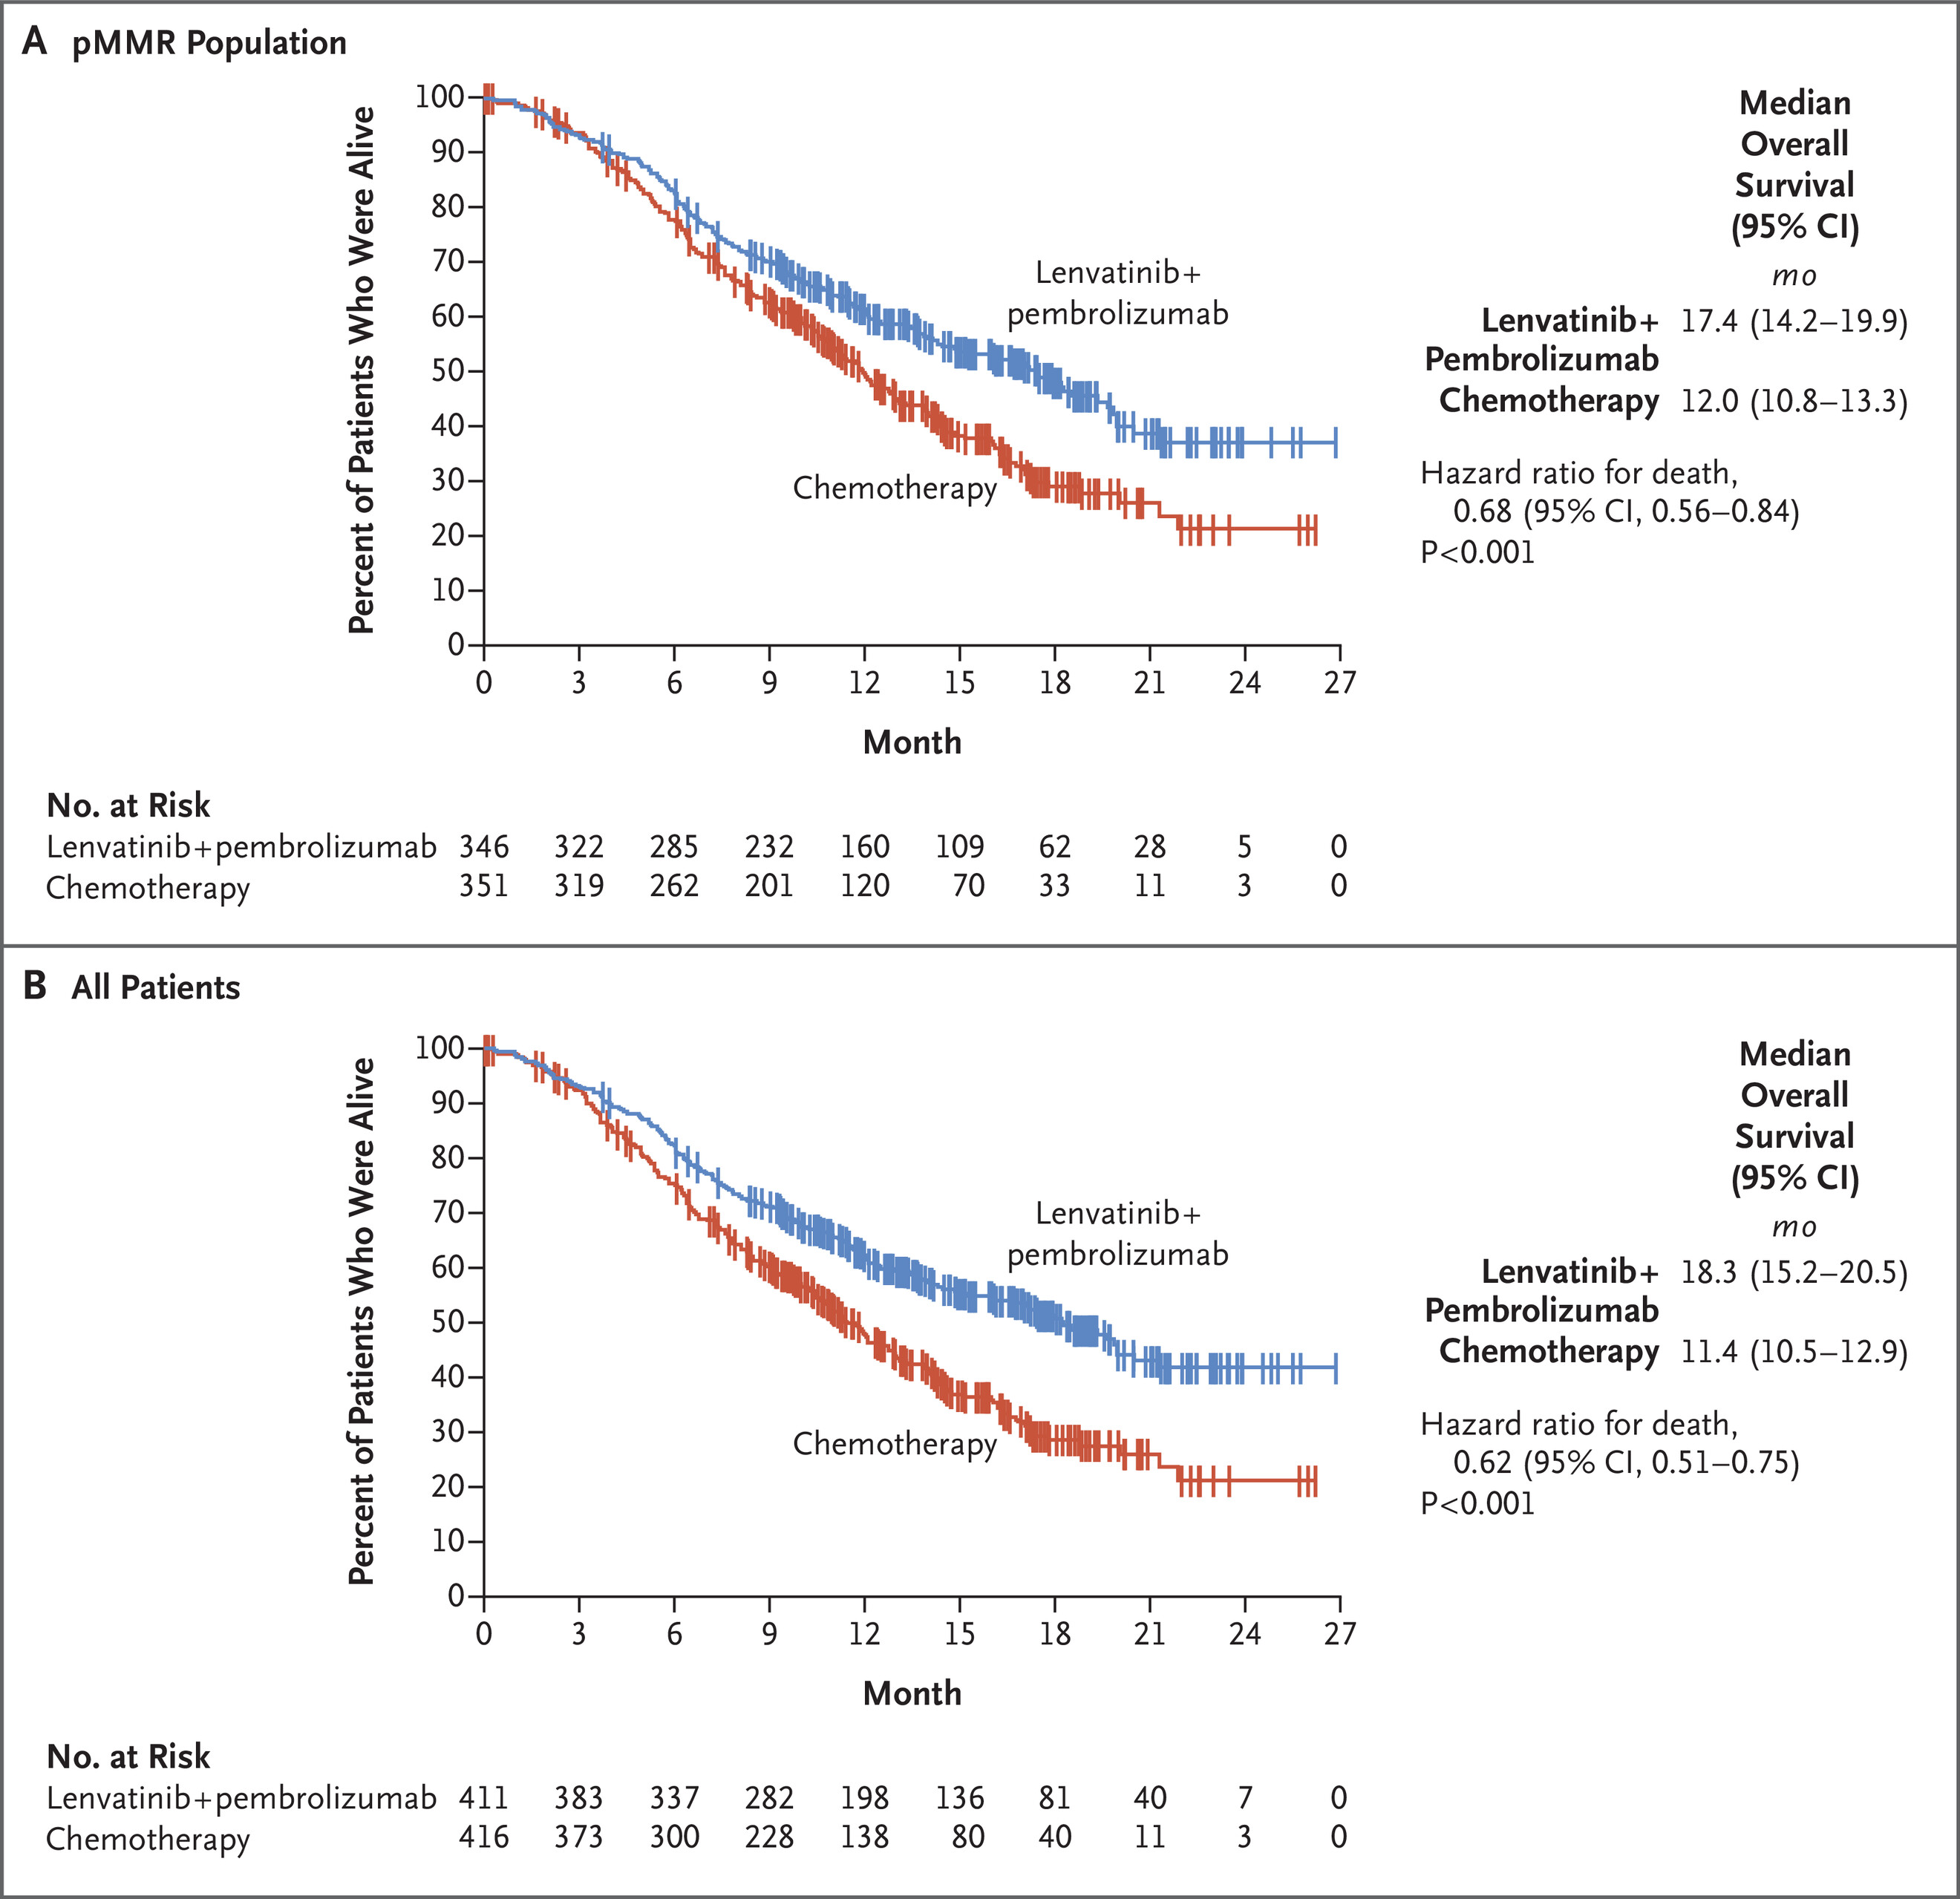
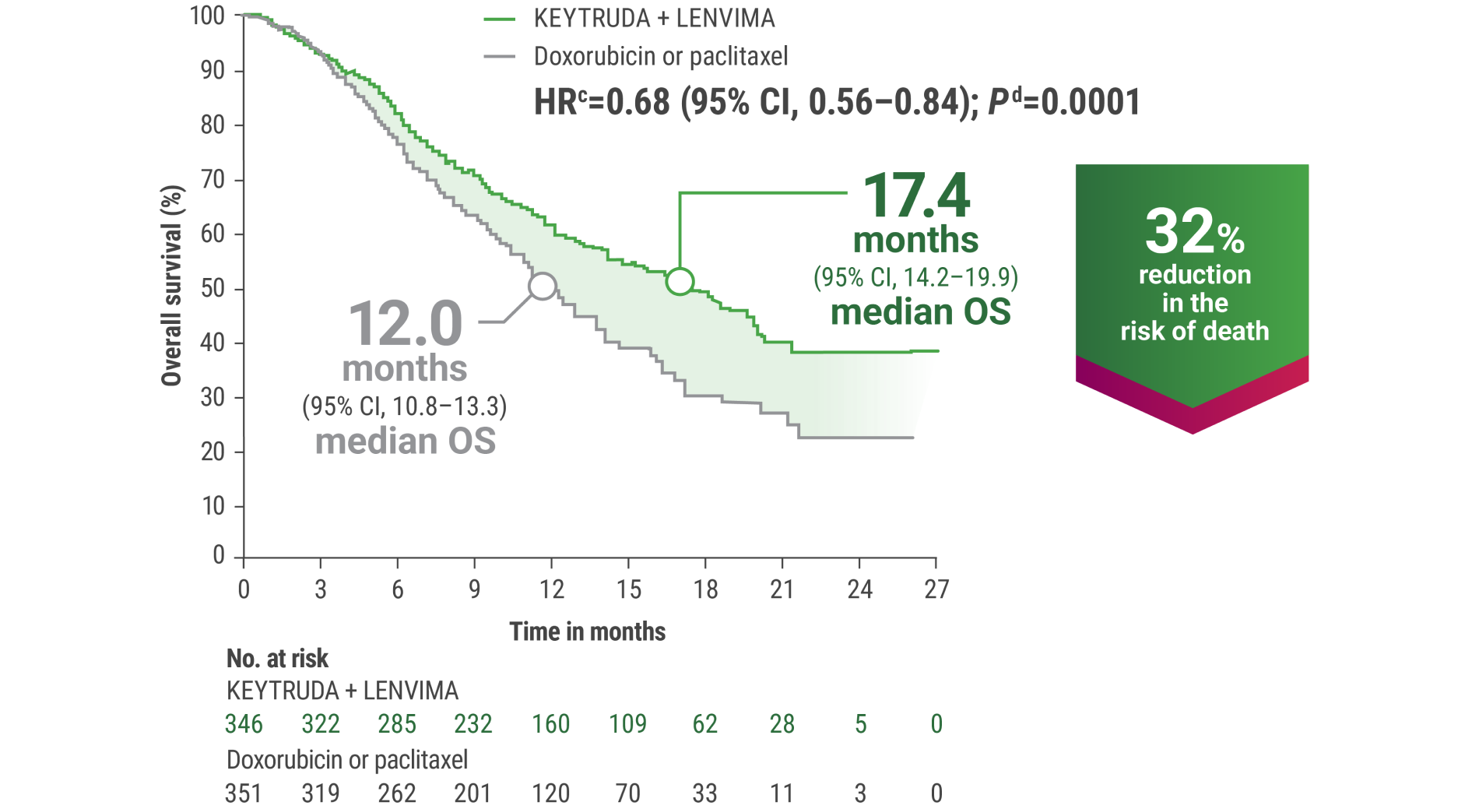
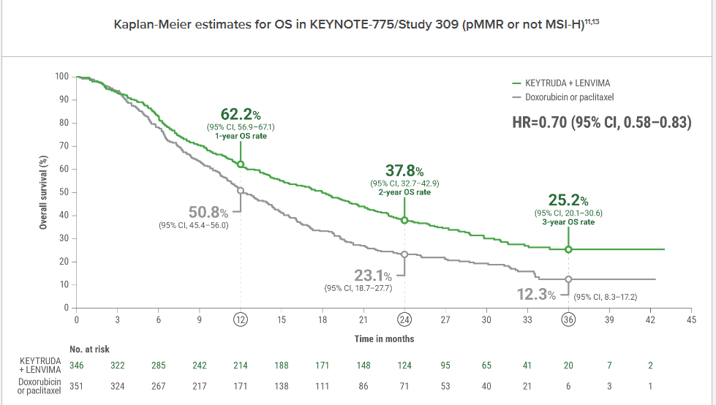
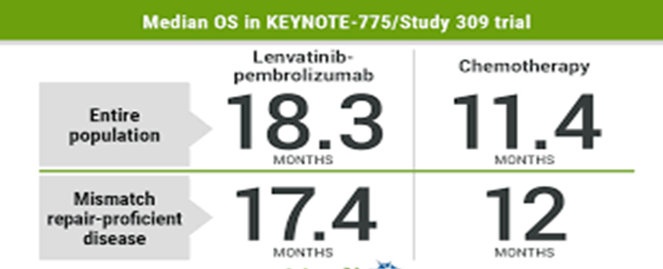
Pembrolizumab + lenvatinib (KEYNOTE-775 / Study 309)
Efficacy : Focus on OS
Patients lived a median of 5.4 months longer with Pembro + Lenvatinib vs doxorubicin or paclitaxel
(17.4 vs 12.0 months, respectively).

Slide 6
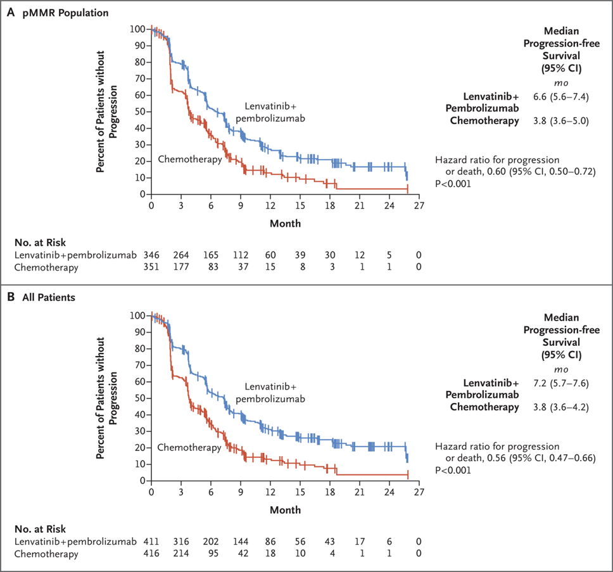
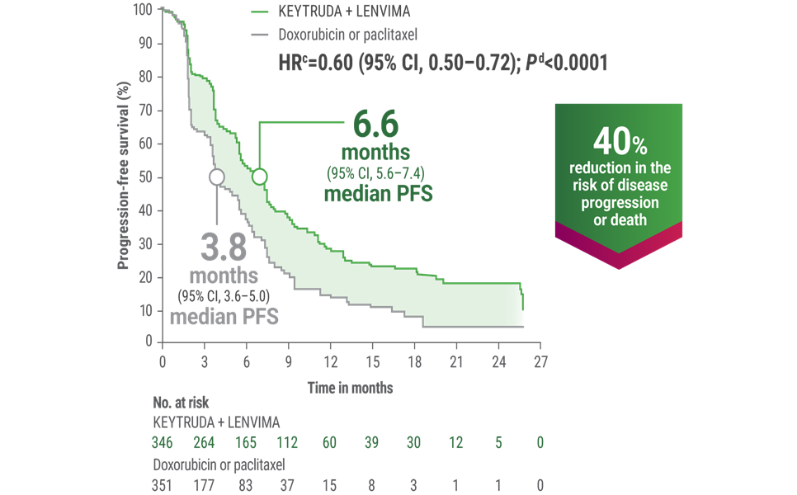
Pembrolizumab + Lenvatinib (KEYNOTE-775 / Study 309)
Efficacy : Focus on progression-free survival
Patients lived with more disease progression–free time with Pembrolizumab + lenvatinib vs doxorubicin or paclitaxel (HRc=0.60 [95% CI, 0.50–0.72]; Pd<0.0001). KEYTRUDA + LENVIMA achieved 6.6 months of median PFS vs 3.8 months with doxorubicin or paclitaxel

Slide 7
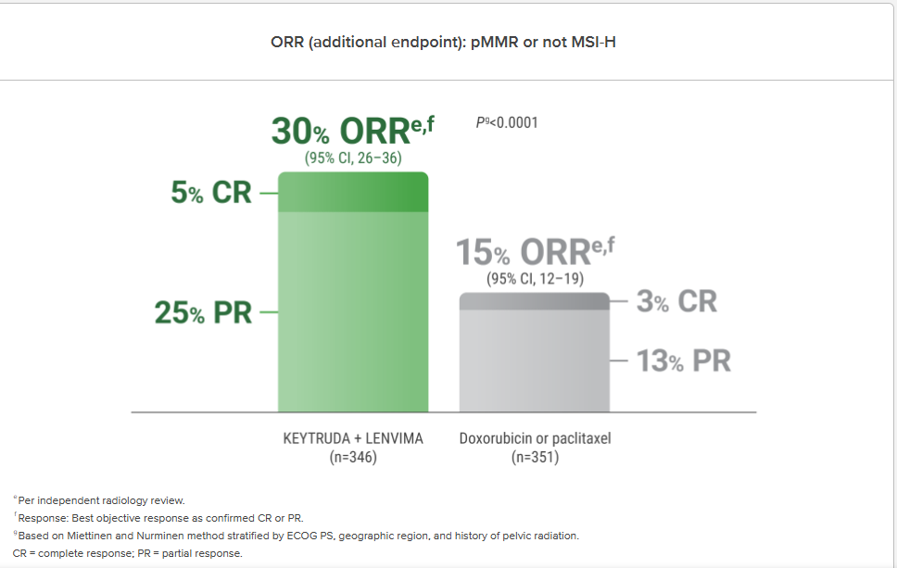
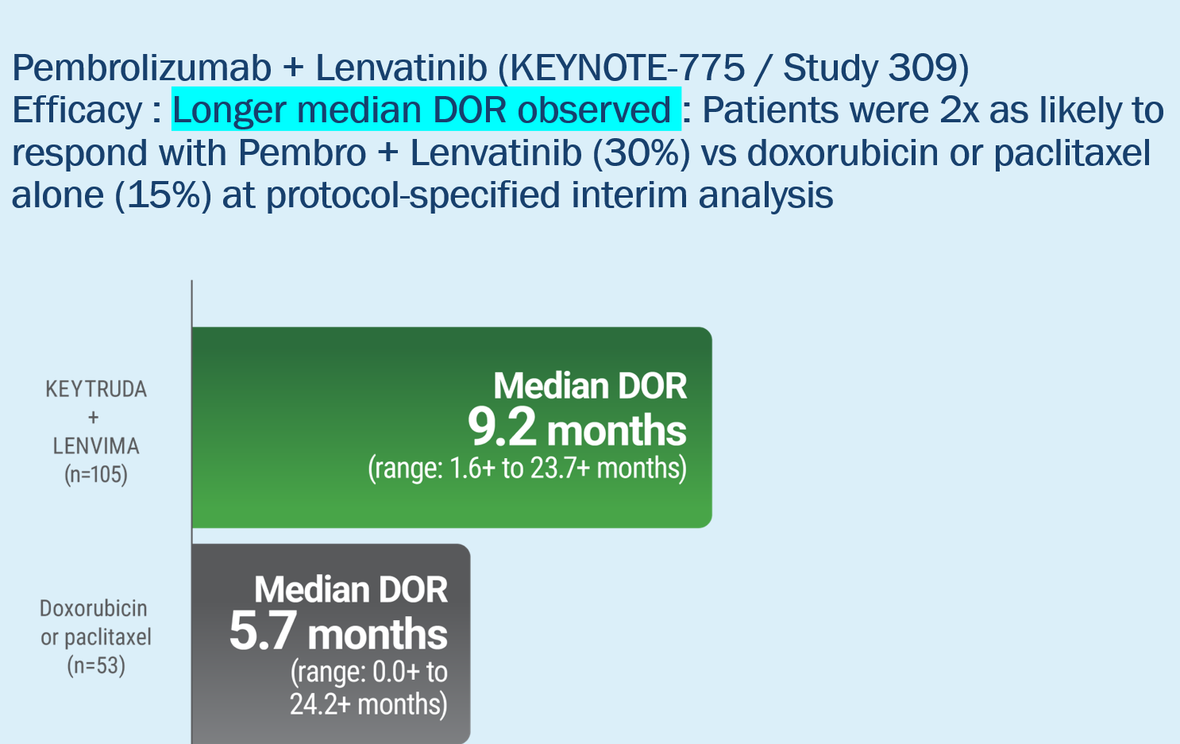
Pembrolizumab + Lenvatinib (KEYNOTE-775 / Study 309)
Efficacy : Proven superior ORR: Patients were 2x as likely to respond with Pembro + Lenvatinib (30%) vs doxorubicin or paclitaxel alone (15%) at protocol-specified interim analysis
Doubled ORR with Pembro + Lenvima vs doxorubicin or paclitaxel.

Slide 8
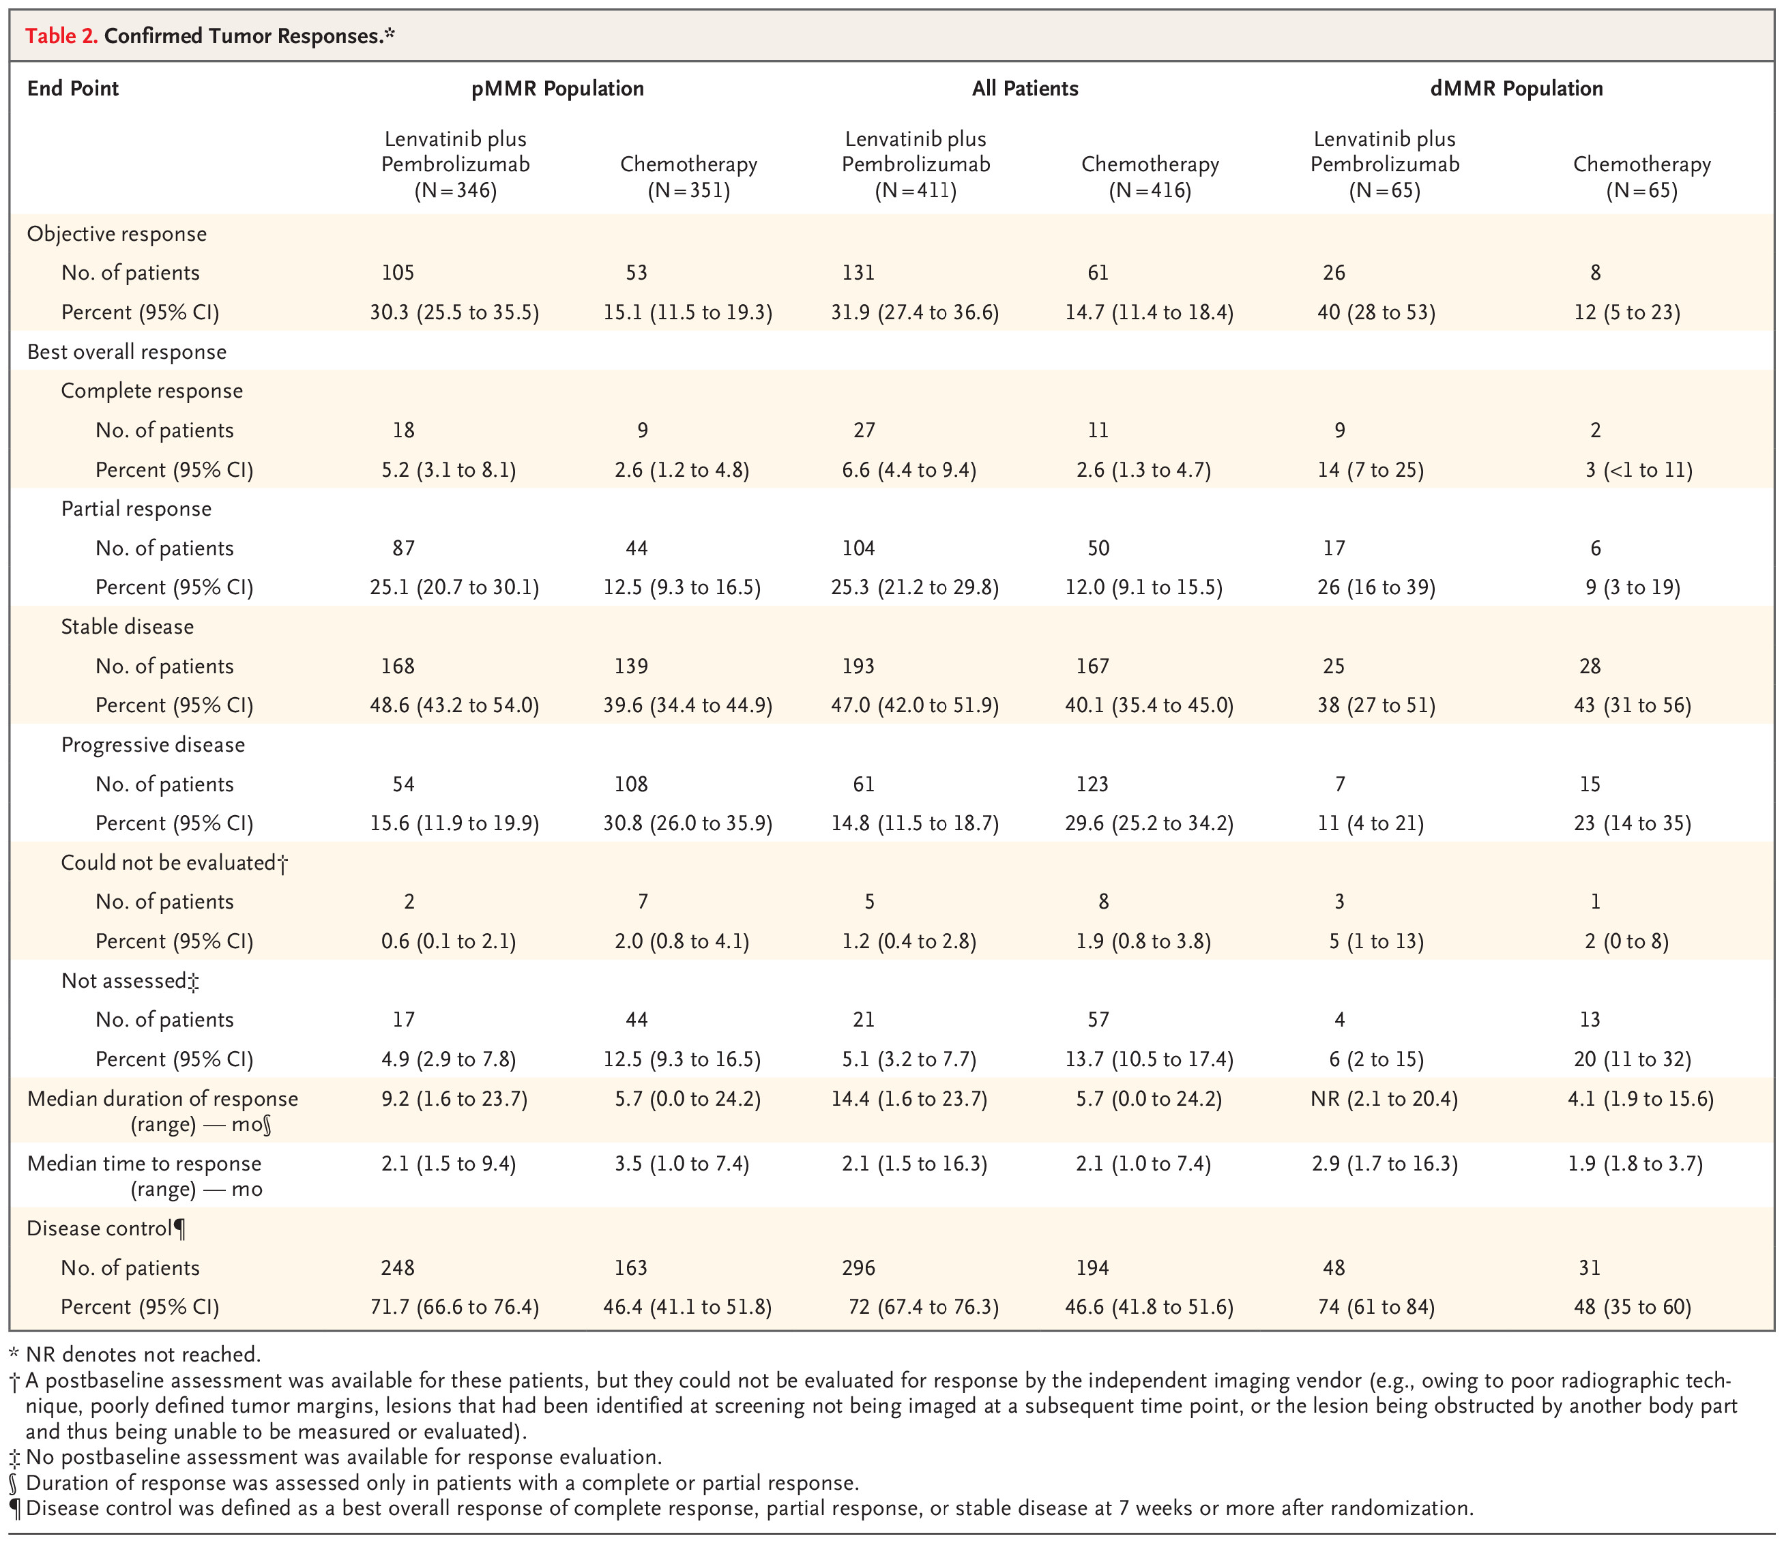
Efficacy
Overall, more patients in the lenvatinib–pembrolizumab group than in the chemotherapy group had tumor shrinkage .
Although the trial was not designed or powered to compare lenvatinib plus pembrolizumab with chemotherapy in the dMMR population, clinically meaningful improvement was observed across efficacy end points

Slide 9
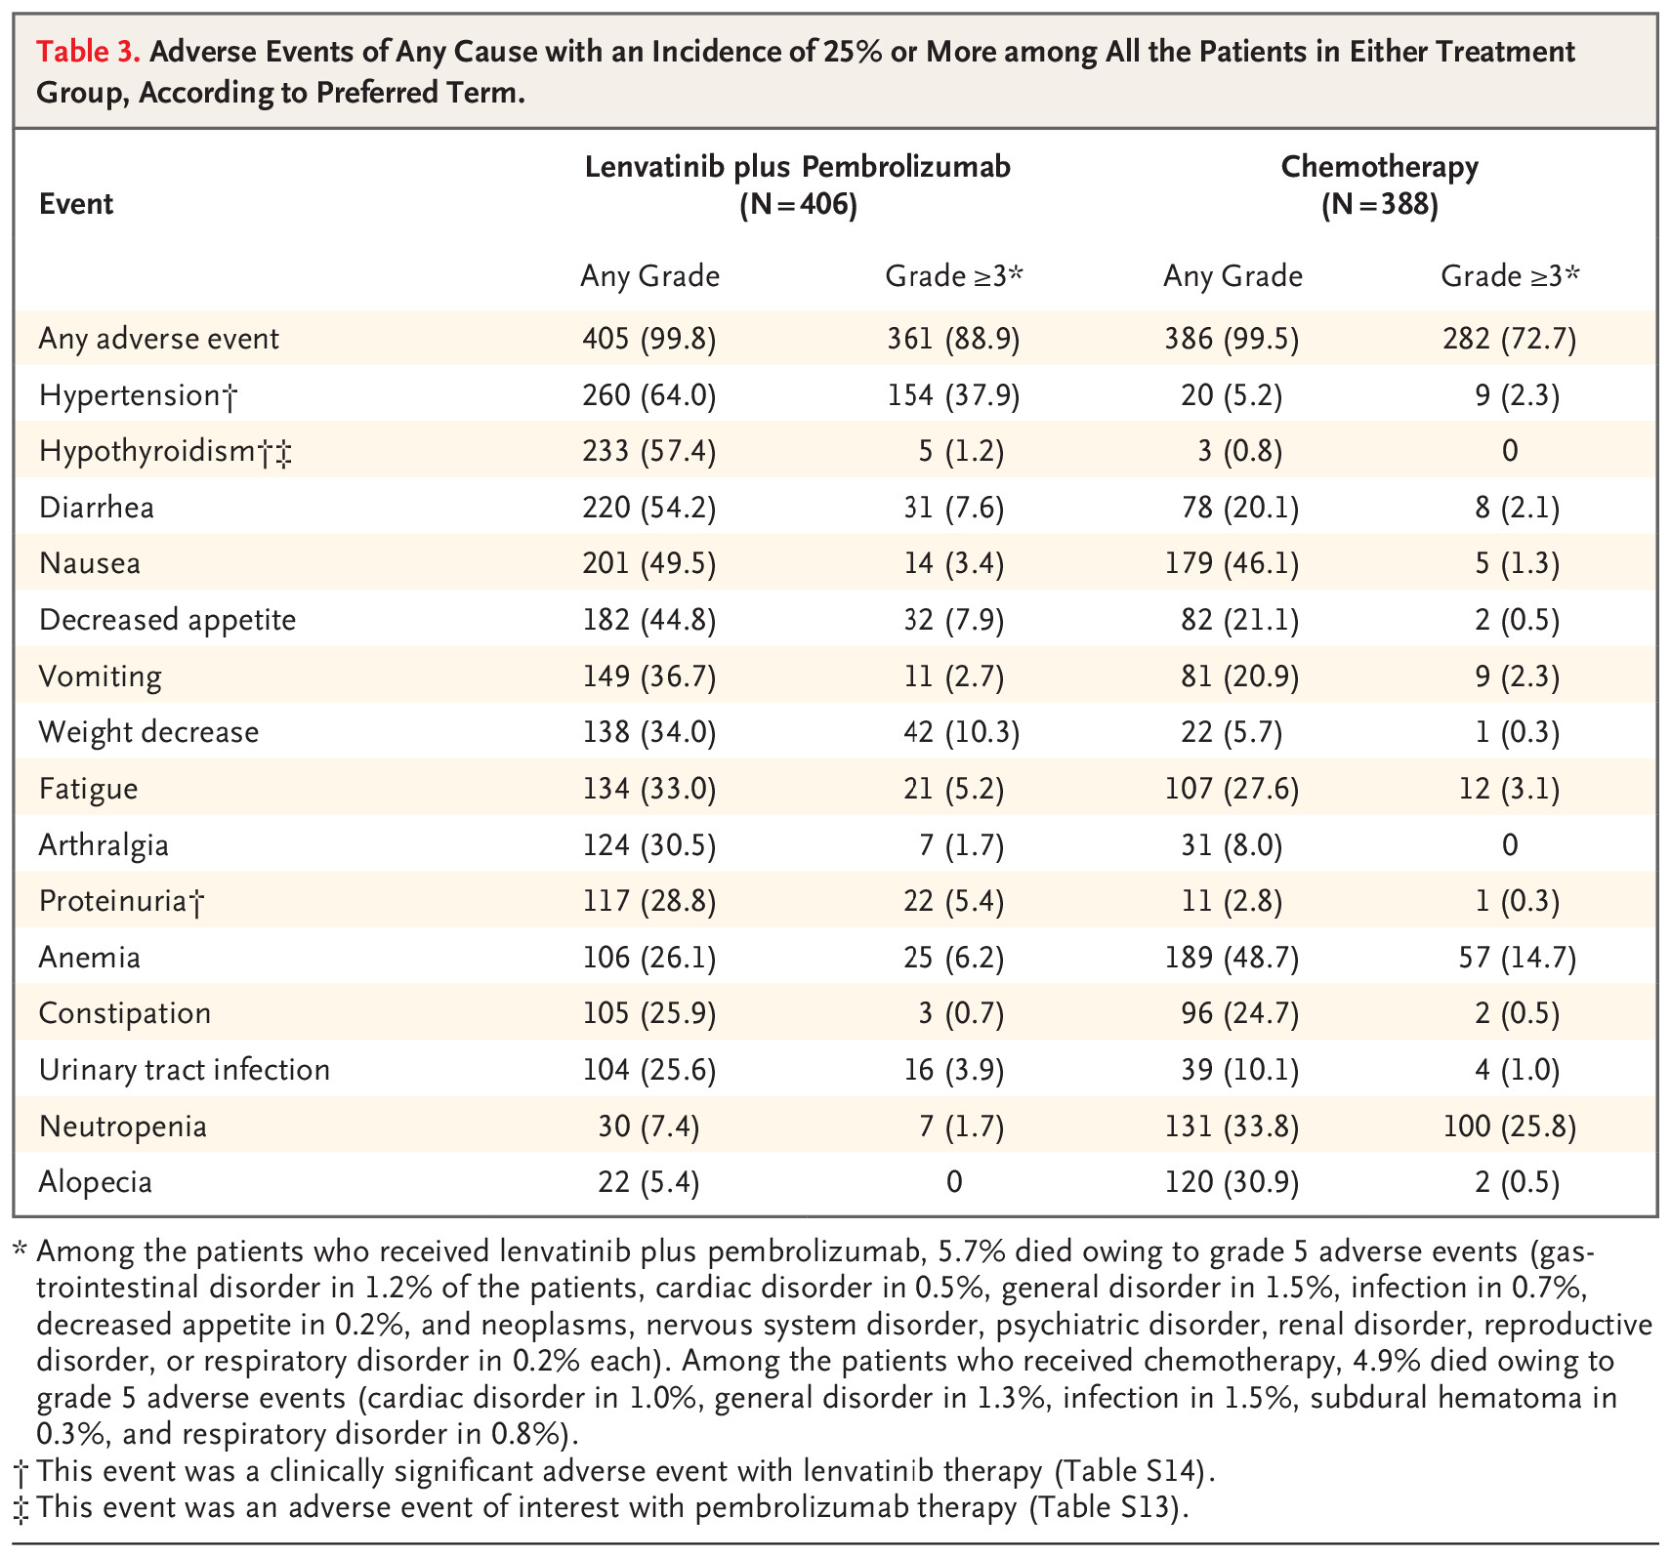
Exposure and Safety
The most common serious adverse events were hypertension (in 4.2% of the patients) with lenvatinib plus pembrolizumab and febrile neutropenia (in 4.1%) with chemotherapy.
Grade 5 adverse events occurred in 5.7% of the patients receiving lenvatinib plus pembrolizumab and in 4.9% of those receiving chemotherapy.

Slide 10
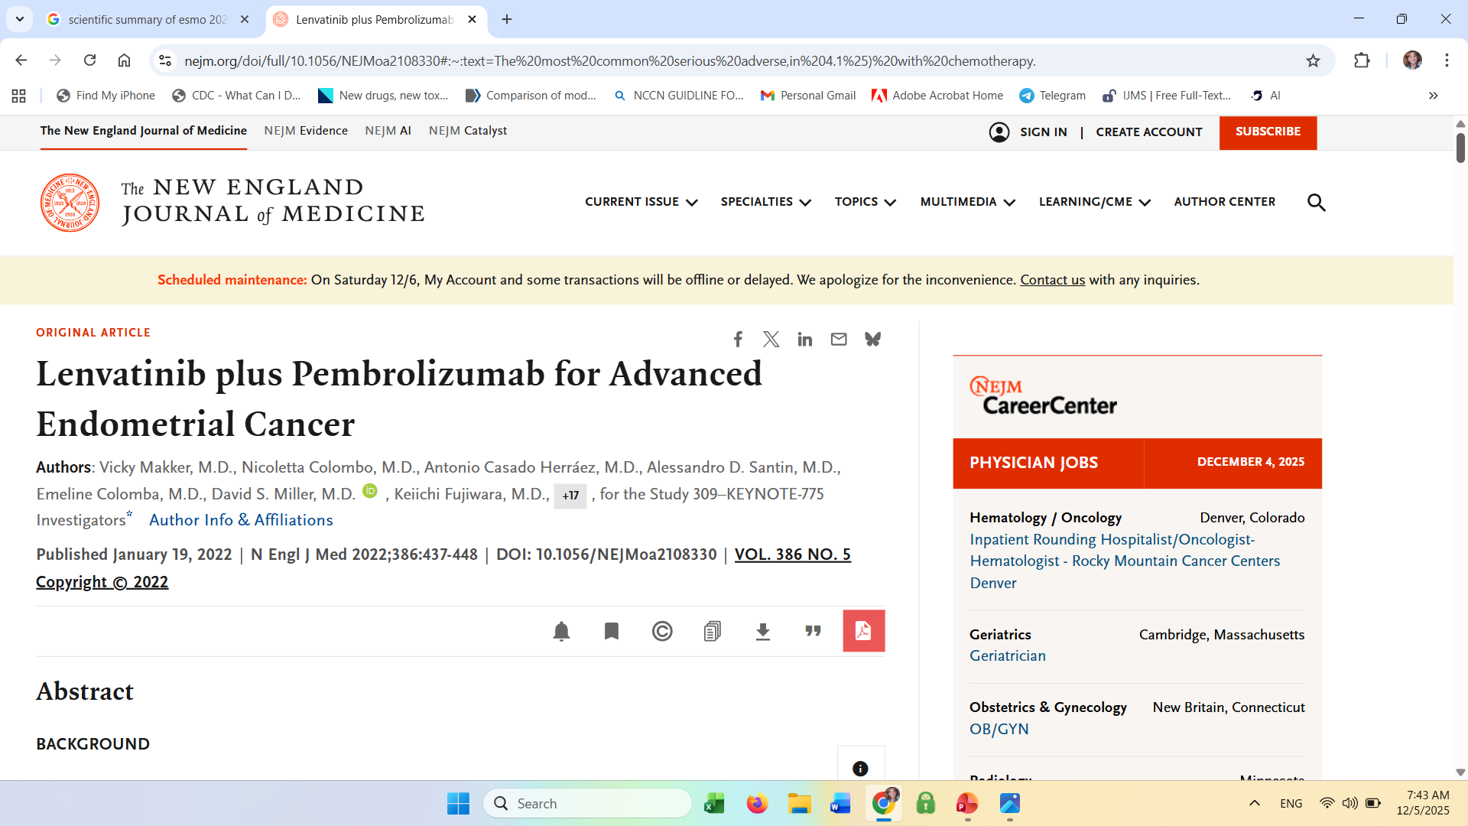
Pembrolizumab + Lenvatinib (KEYNOTE-775 / Study 309)
Focus on fatal and serious adverse reactions
Almost all the patients in the two treatment groups (>99%) had adverse events during treatment, with the most common being hypertension (in 64.0% of the patients) with lenvatinib plus pembrolizumab and anemia (in 48.7%) with chemotherapy .
Grade 3 or higher adverse events occurred in 88.9% of the patients receiving lenvatinib plus pembrolizumab and in 72.7% of those receiving chemotherapy.
The most common serious adverse events were hypertension (in 4.2% of the patients) with lenvatinib plus pembrolizumab and febrile neutropenia (in 4.1%) with chemotherapy.
Grade 5 adverse events (regardless of the investigator’s assessment of relation to treatment) occurred in 5.7% of the patients receiving lenvatinib plus pembrolizumab and in 4.9% of those receiving chemotherapy.

Slide 11
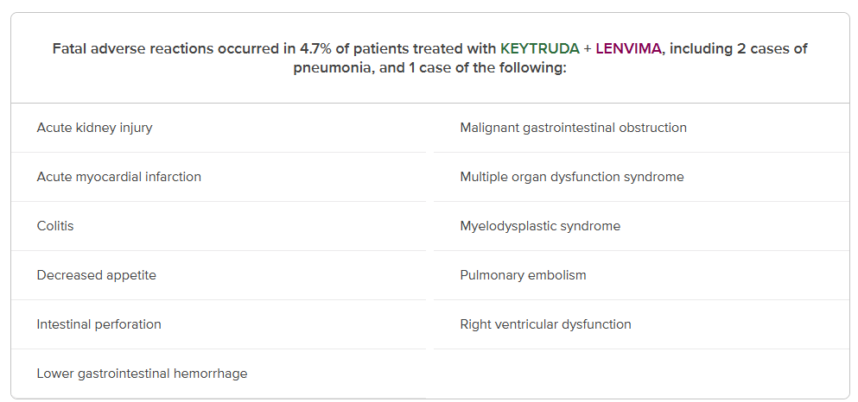
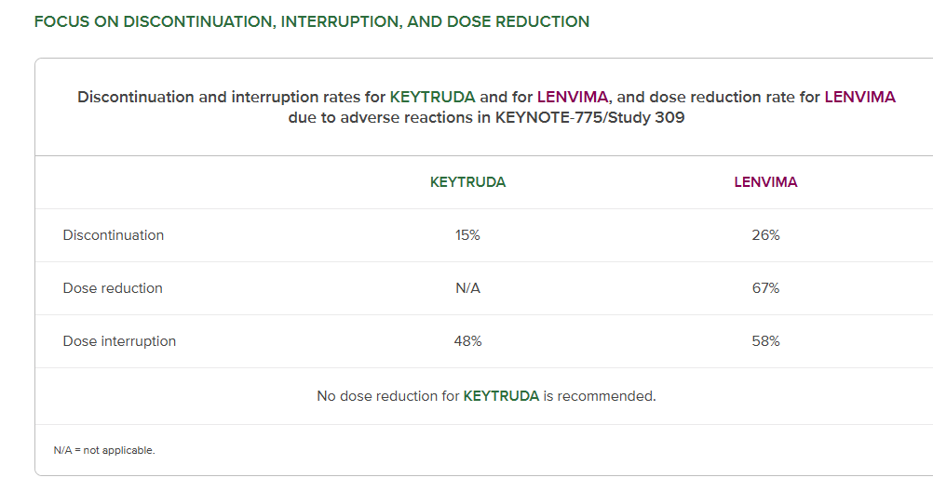
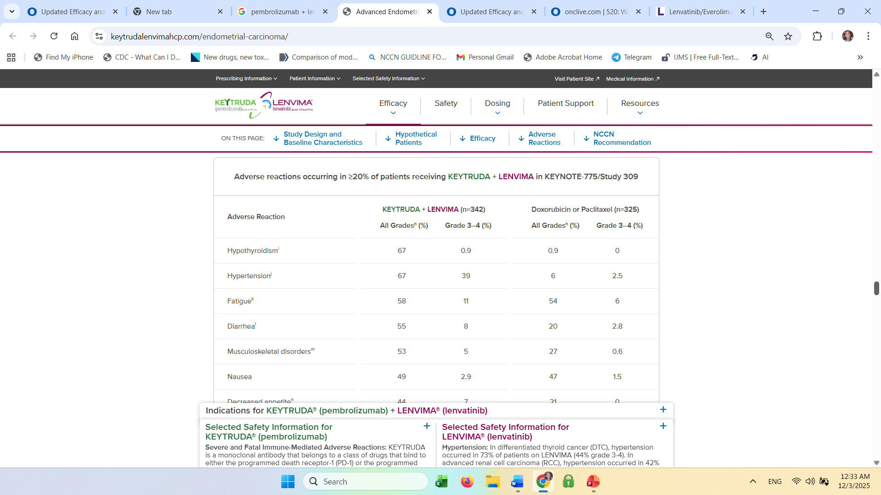
Pembrolizumab + Lenvatinib (KEYNOTE-775 / Study 309)
Focus on fatal and serious adverse reactions
Serious adverse reactions occurred in 50% of patients

Slide 12
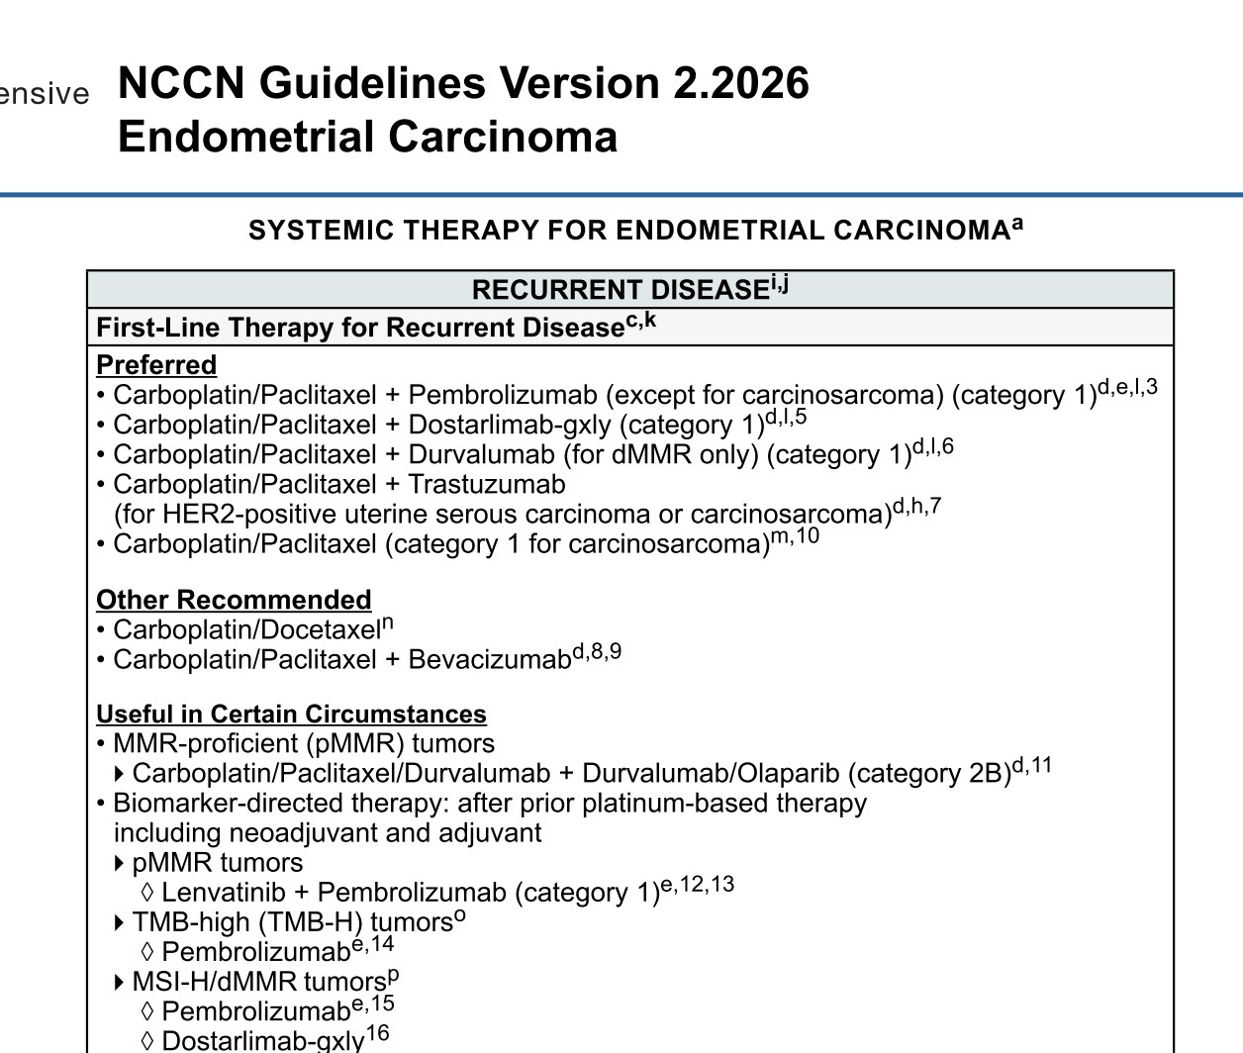
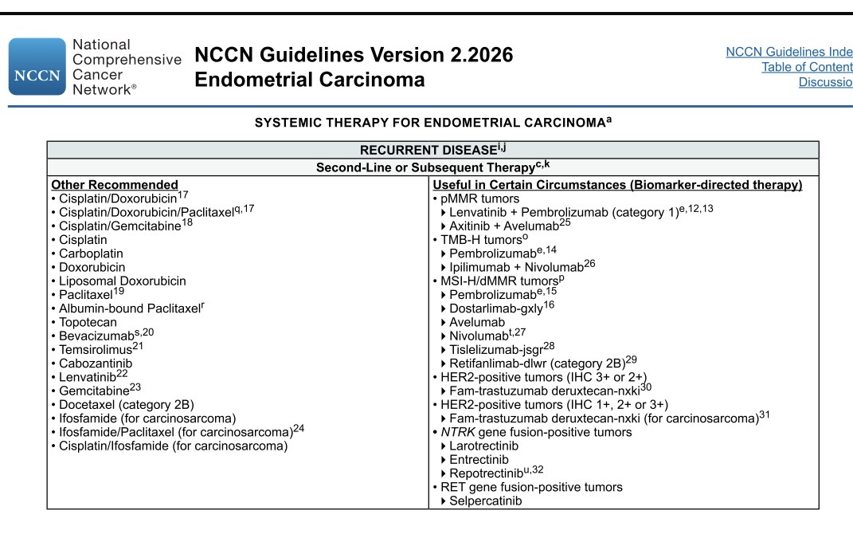

Slide 13
Pembrolizumab + lenvatinib (KEYNOTE-775 / Study 309)
Key findings from the ESMO 2025 update
Durable survival benefit:
The combination of lenvatinib and pembrolizumab provided a sustained overall survival (OS) benefit for patients with advanced endometrial carcinoma who had received at least one prior platinum-based chemotherapy regimen.
5-year overall survival:
The 5-year OS rate was 16.7% for the lenvatinib and pembrolizumab arm, compared to 7.3% for the chemotherapy group.
Median survival:
The median OS was 18.0 months for the combination therapy versus 12.2 months for the chemotherapy group.
No new safety concerns:
The long-term follow-up did not reveal any new safety signals beyond the known profile of each agent.
Established treatment role: The updated data further support the established role of this combination as an effective treatment option, reinforcing its value for patients facing this disease.
.
Notes:
e
Per independent radiology review.
f
Response: Best objective response as confirmed CR or PR.
g
Based on Miettinen and Nurminen method stratified by ECOG PS, geographic region, and history of pelvic radiation.
CR = complete response; PR = partial response.

Slide 14




